Slide 1
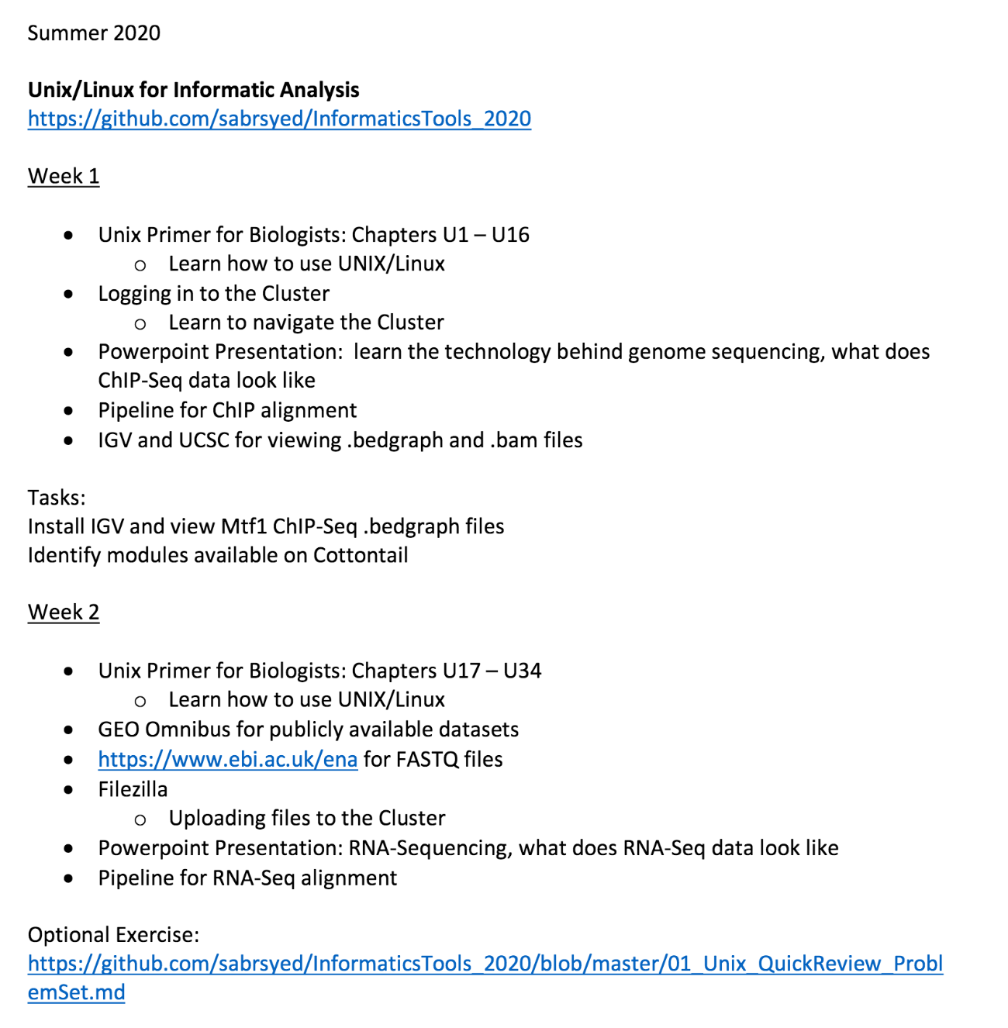

Slide 2
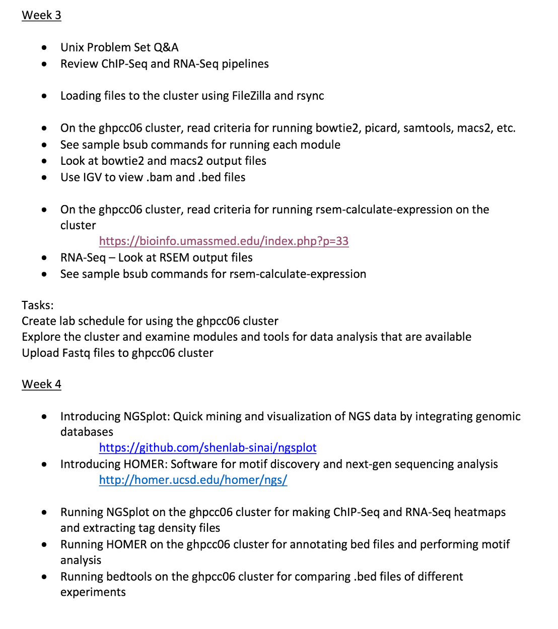

Slide 3
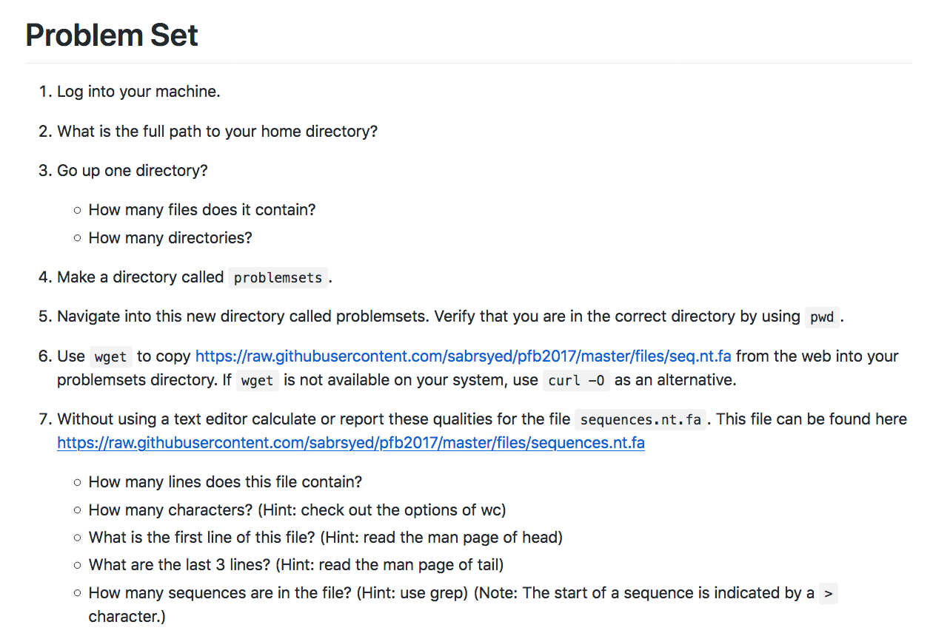

Slide 4
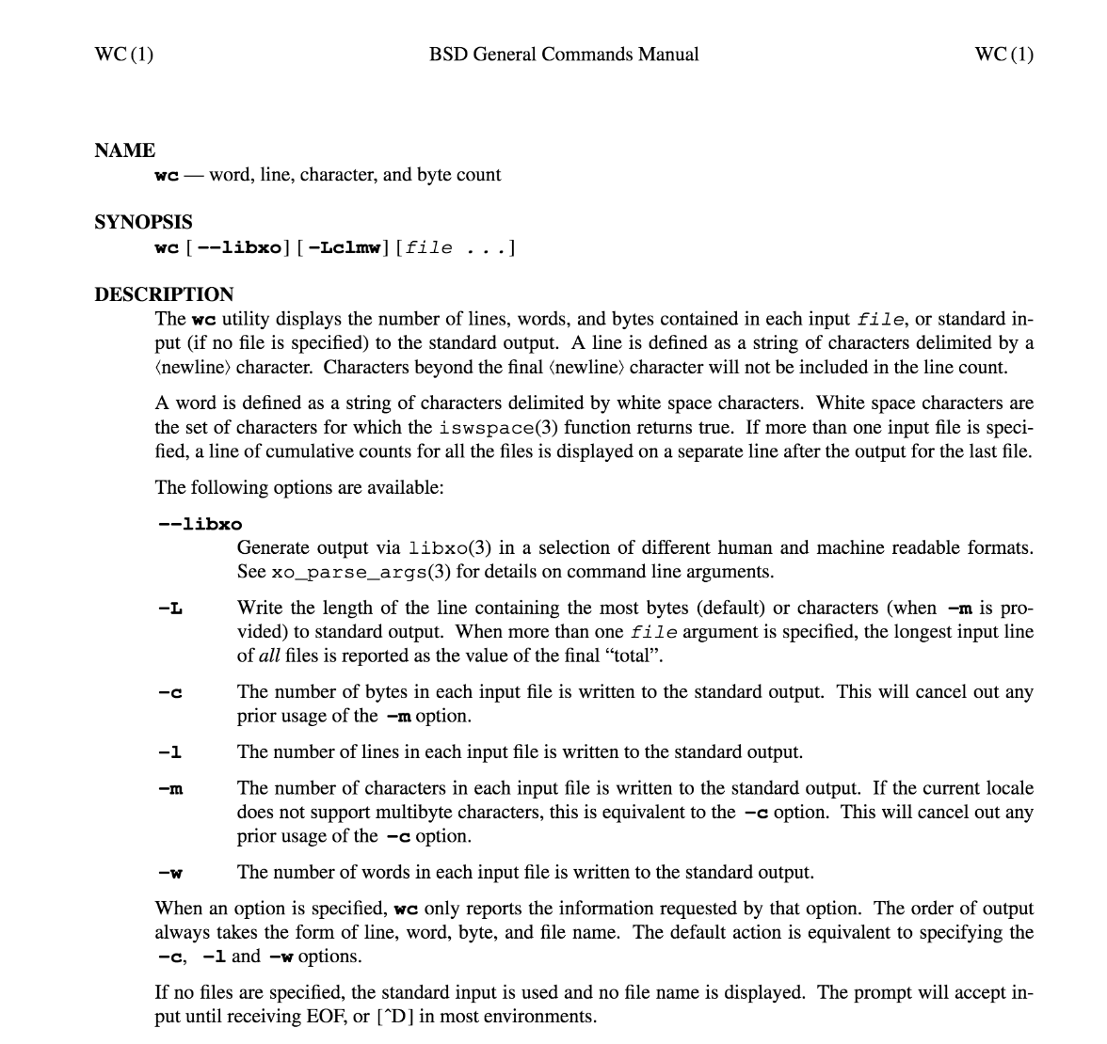

Slide 6
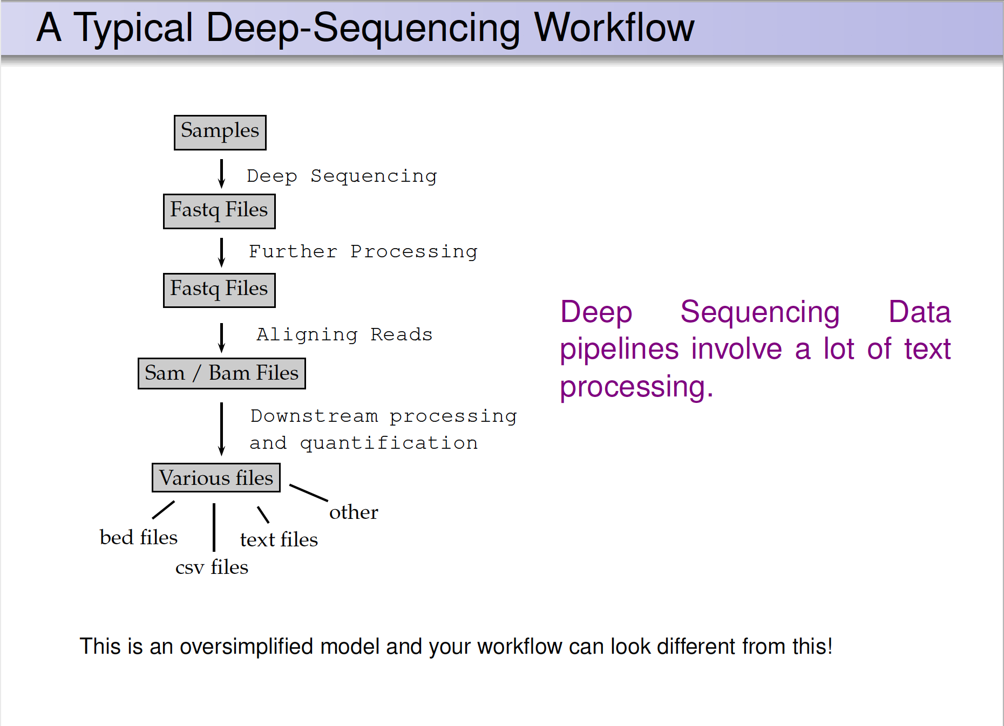
HiChIP pipeline

Slide 7
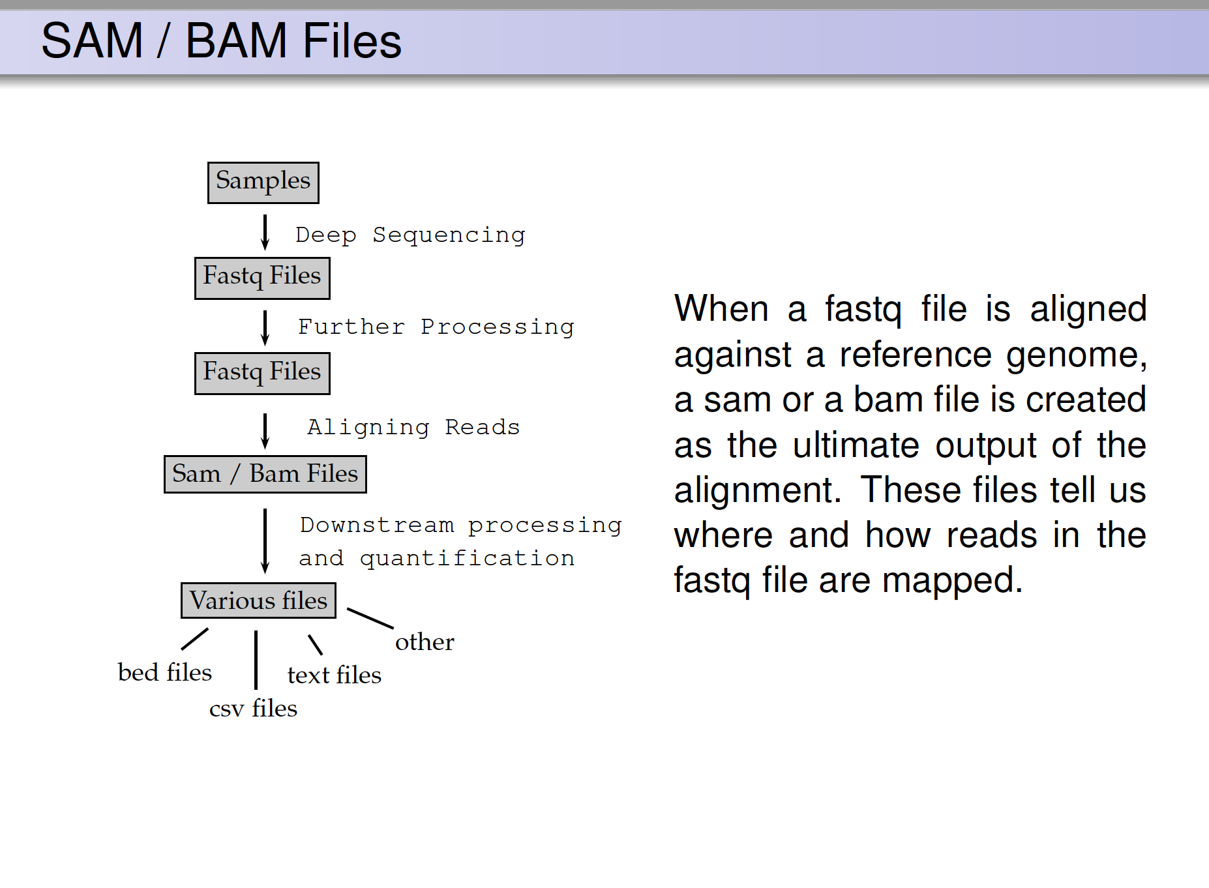
ChIP pipeline
FASTQ: a text-based format for storing nucleotide sequences (reads) and their quality scores. [1]
BAM: The Sequence Alignment/Mapping (SAM) format is a text-based format for storing read alignments against reference sequences and it is interconvertible with the binary BAM format. [2]

Slide 8
My ChIP-Sequencing Workflow
Raw Reads
fastq
.tdf to visualize
(IGV tools)
Map to genome (Bowtie2)
Bam Index (picard)
Sort Sam
(picard)
MAPQ filter (samtools)
Peak Analysis
(macs2)
Mark duplicates
(picard)
Merge runs
(picard)

Slide 9
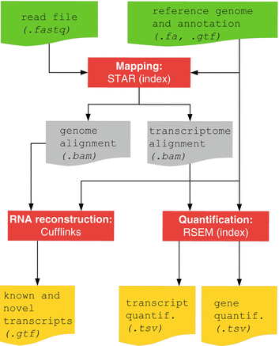
RNA-Seq Pipline
Methods and Tools
Bowtie and Bowtie2 use Burrows-Wheeler indexing for aligning reads. With bowtie2 there is no upper limit on the read length
Bowtie2
Bowtie2 to align reads in a splice-aware manner and aids the discovery of new splice junctions
RSEM is a software package for estimating gene and isoform expression levels from RNA-Seq data. The RSEM package provides an user-friendly interface, supports threads for parallel computation of the EM algorithm, single-end and paired-end read data, quality scores, variable-length reads and RSPD estimation.

Slide 10
My ChIP-Sequencing Workflow
Raw Reads
fastq
.tdf to visualize
(IGV tools)
Map to genome (Bowtie2)
Bam Index (picard)
Sort Sam
(picard)
MAPQ filter (samtools)
Peak Analysis
(macs2)
Mark duplicates
(picard)
Merge runs
(picard)

Slide 11
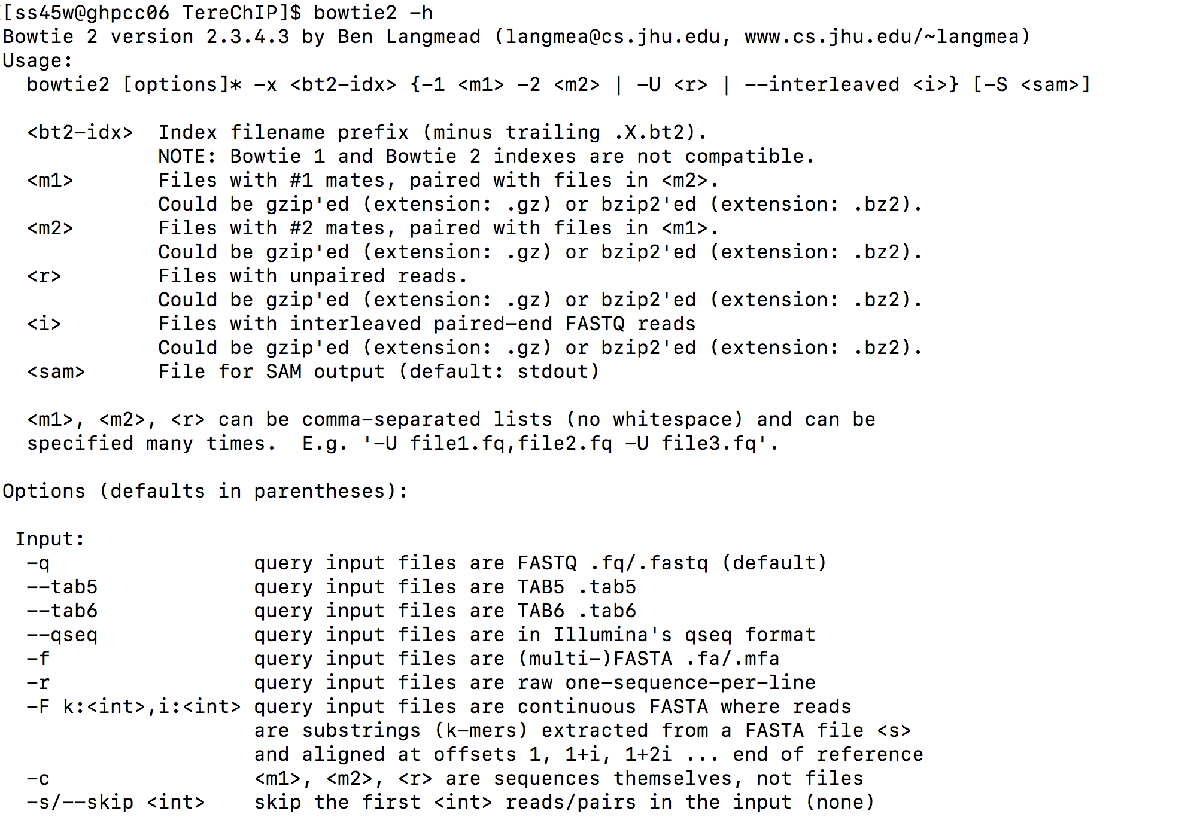

Slide 12
#Alignment
.fastq --> .sam using bowtie2 default settings
#example
module load bowtie2/2.3.4.3
bsub -q long -o log -n 1 -R rusage[mem=20000] -R span[hosts=1] -W 480 "bowtie2 -x /share/data/umw_biocore/genome_data/mouse/mm10/mm10 –q /nl/umw_anthony_imbalzano/Sabriya/TereChIP/ProlnoCu_IN_rep1.fq.gz -S ProlnoCu_IN_rep1.sam"

Slide 13
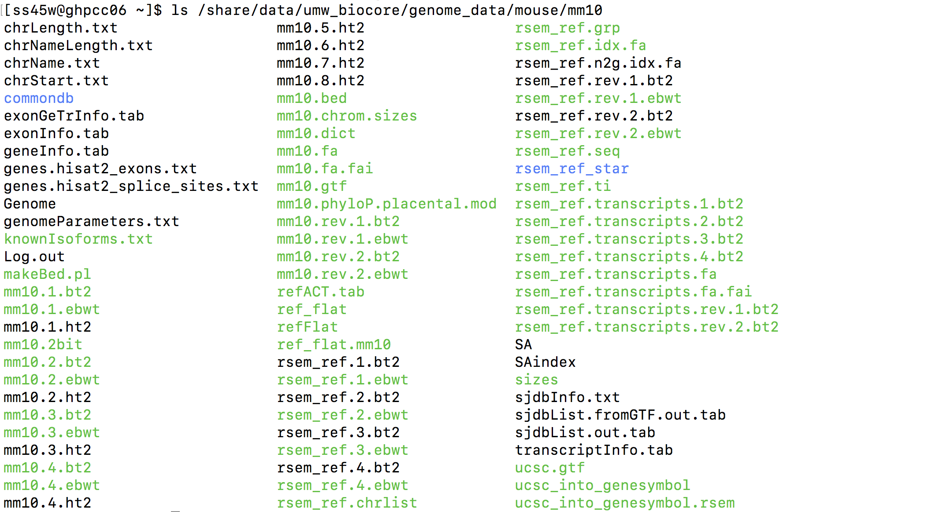

Slide 14
Bowtie2 sample output
[ss45w@ghpcc06 ChIP-Seq_1]$ bsub -q interactive -n 4 -R rusage[mem=4096] -R span[hosts=1] -W 360 -Is "bowtie2 -x /share/data/umw_biocore/genome_data/mouse/mm10/mm10 -q -1 LIB034321_CHS00123006_S1_L001_R1.fastq.bz2 -2 LIB034321_CHS00123006_S1_L001_R2.fastq.bz2 -S LIB034321_CHS00123006_S1_L001.sam"
Job <4575939> is submitted to queue <interactive>.
Log file output:
Warning: gzbuffer added in zlib v1.2.3.5. Unable to change buffer size from default of 8192.
Warning: gzbuffer added in zlib v1.2.3.5. Unable to change buffer size from default of 8192.
2803003 reads; of these:
2803003 (100.00%) were paired; of these:
482561 (17.22%) aligned concordantly 0 times
1761290 (62.84%) aligned concordantly exactly 1 time
559152 (19.95%) aligned concordantly >1 times
----
482561 pairs aligned concordantly 0 times; of these:
156820 (32.50%) aligned discordantly 1 time
----
325741 pairs aligned 0 times concordantly or discordantly; of these:
651482 mates make up the pairs; of these:
490472 (75.29%) aligned 0 times
71150 (10.92%) aligned exactly 1 time
89860 (13.79%) aligned >1 times
91.25% overall alignment rate

Slide 15
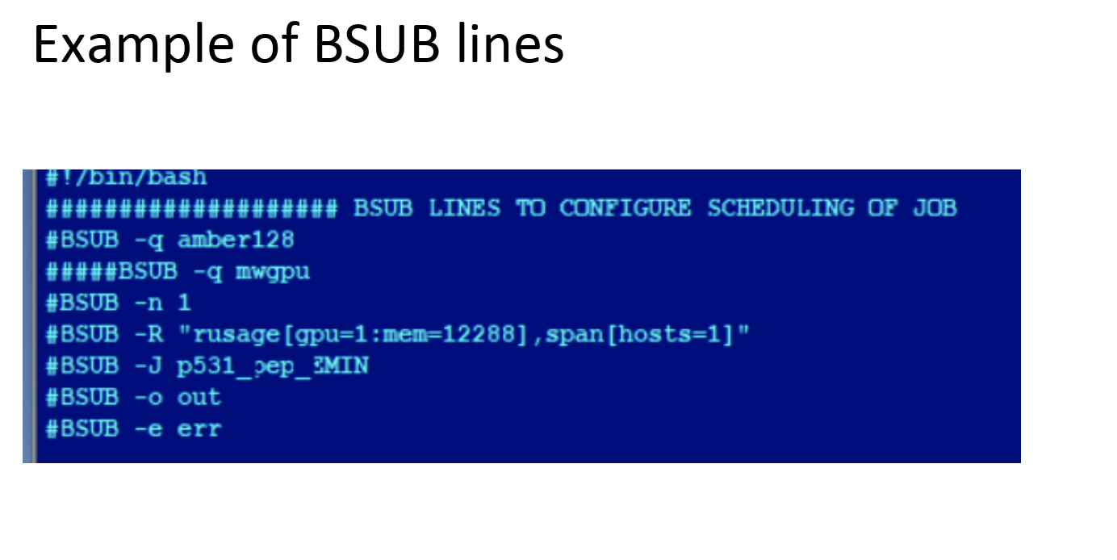

Slide 16
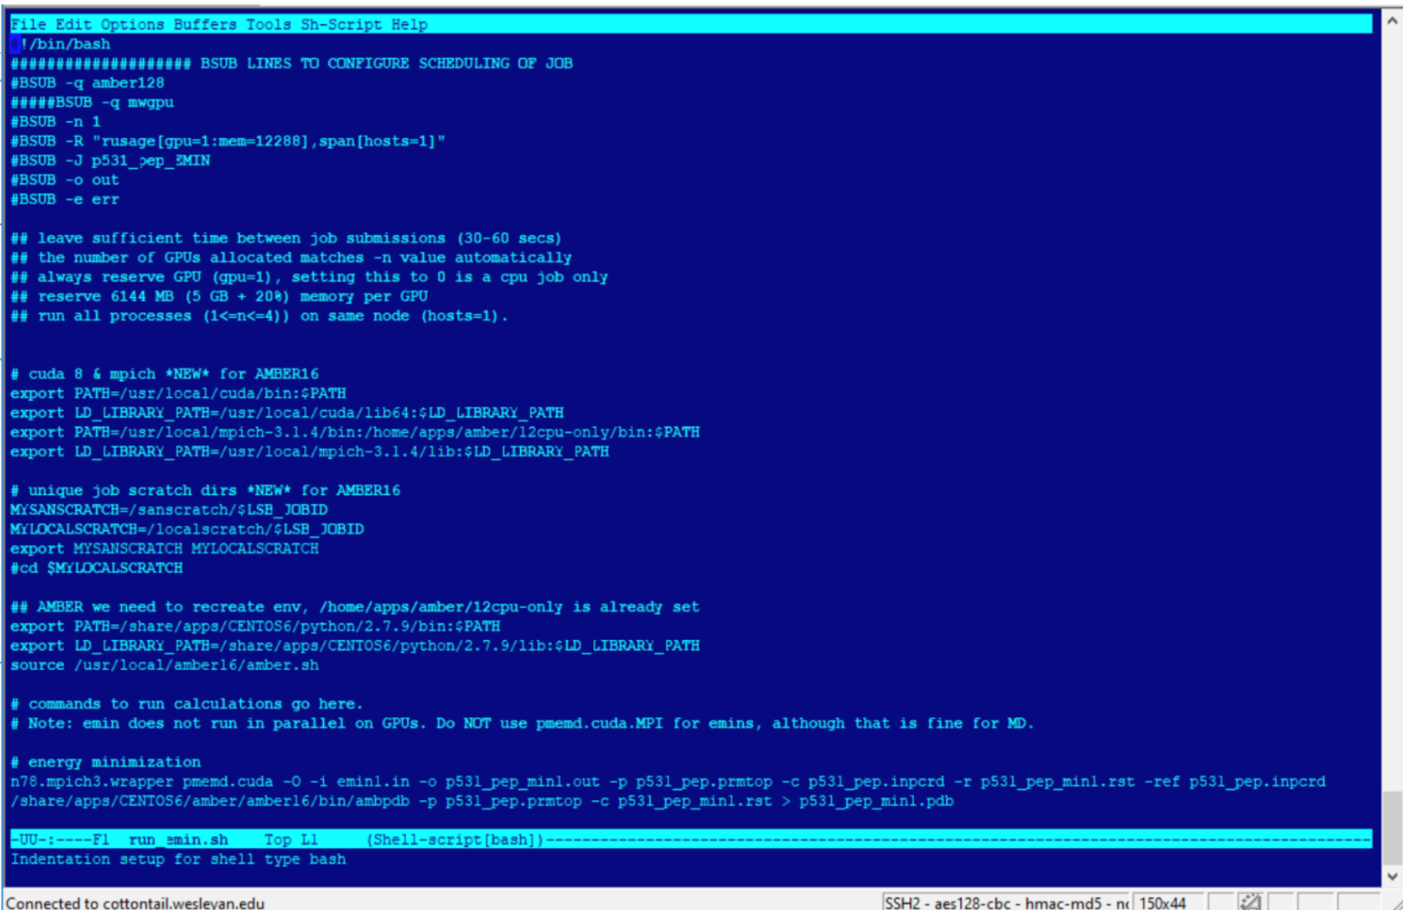

Slide 17
My ChIP-Sequencing Workflow
Raw Reads
fastq
.tdf to visualize
(IGV tools)
Map to genome (Bowtie2)
Bam Index (picard)
Sort Sam
(picard)
MAPQ filter (samtools)
Peak Analysis
(macs2)
Mark duplicates
(picard)
Merge runs
(picard)

Slide 18
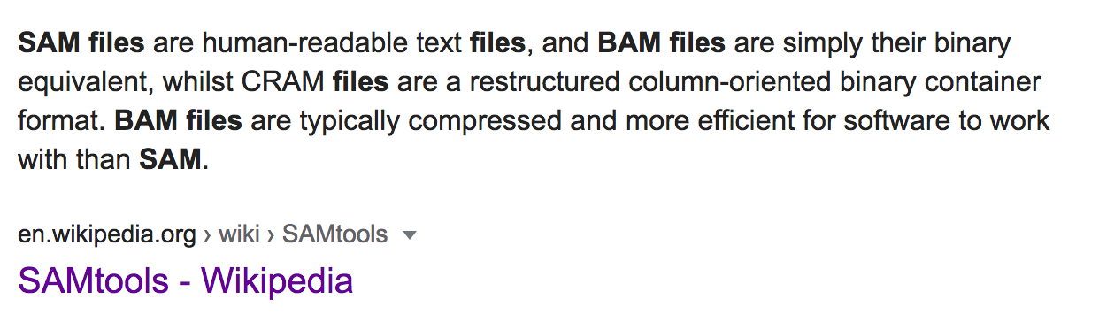
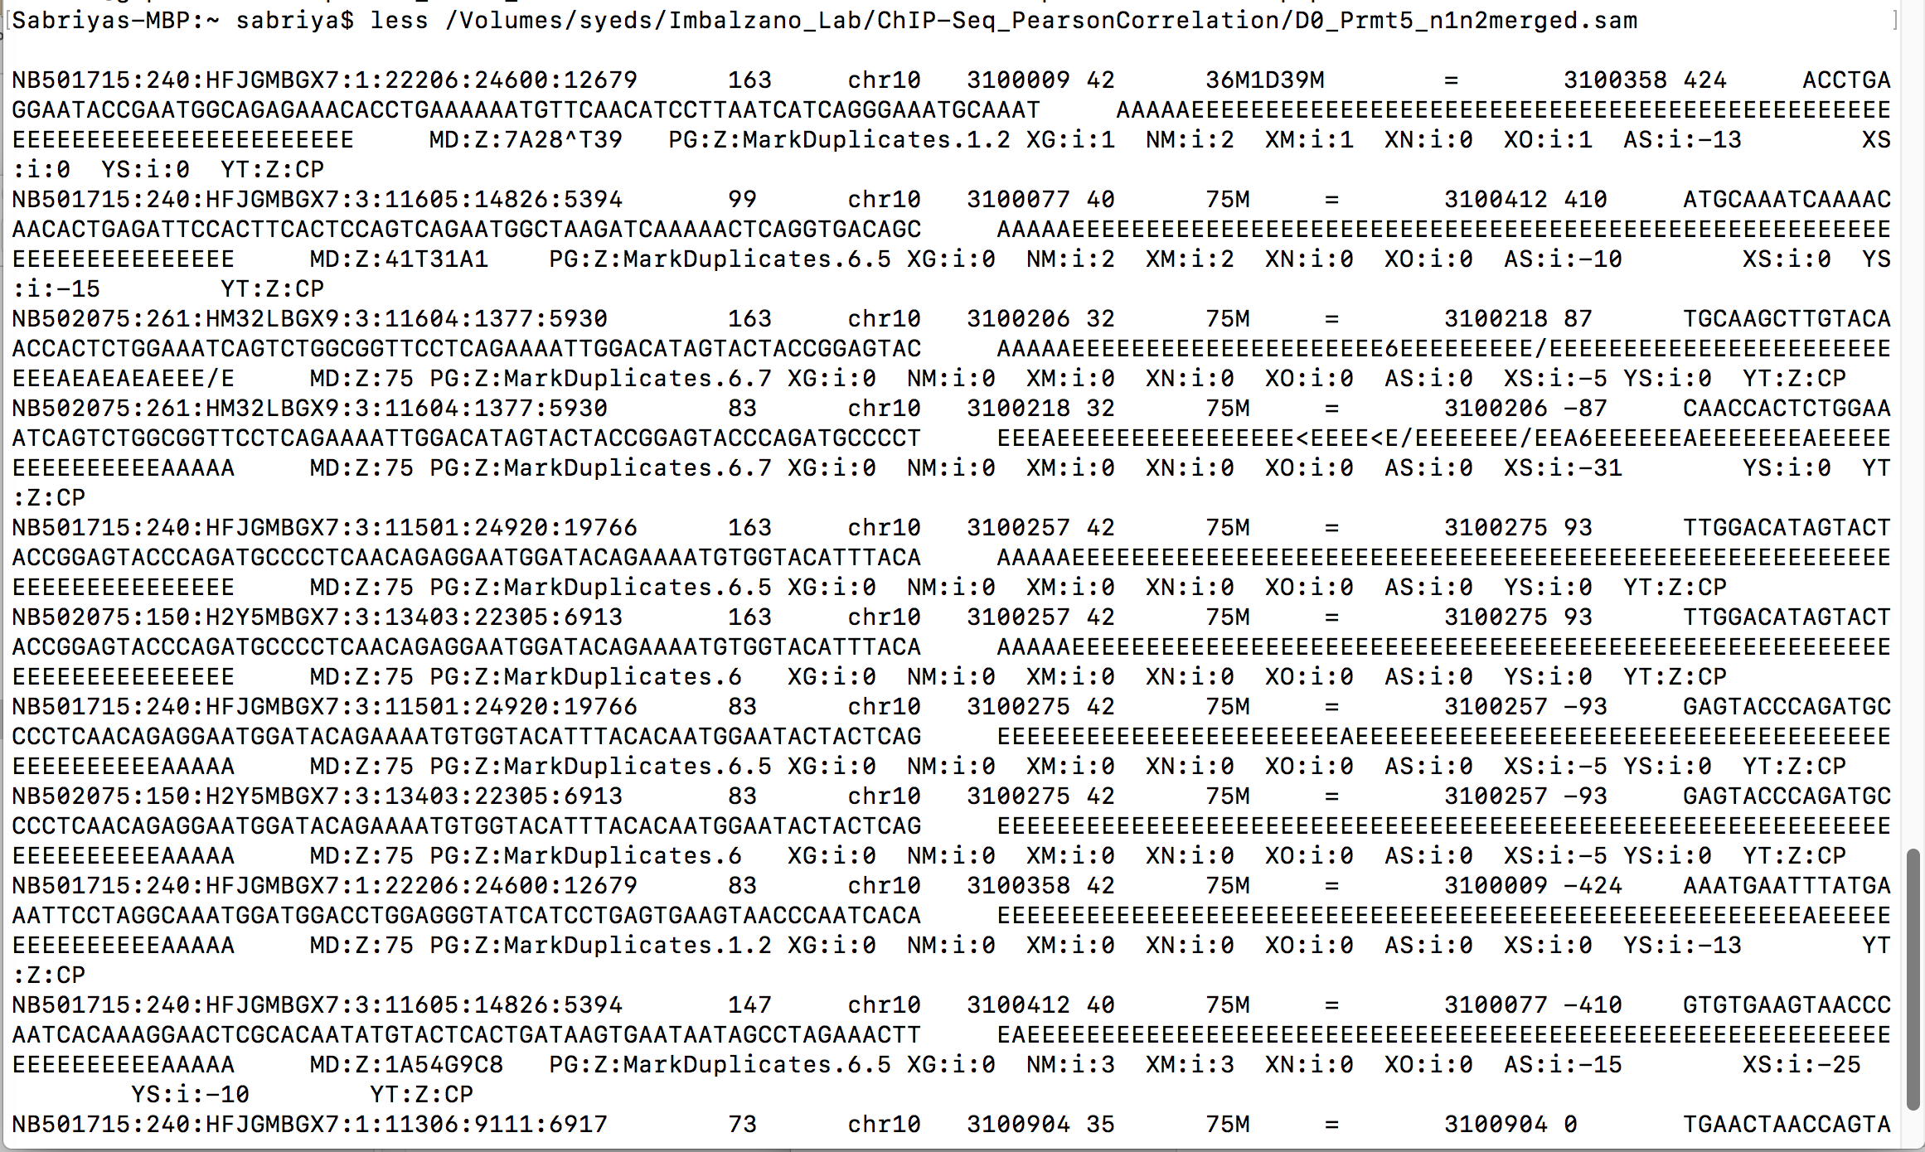

Slide 19
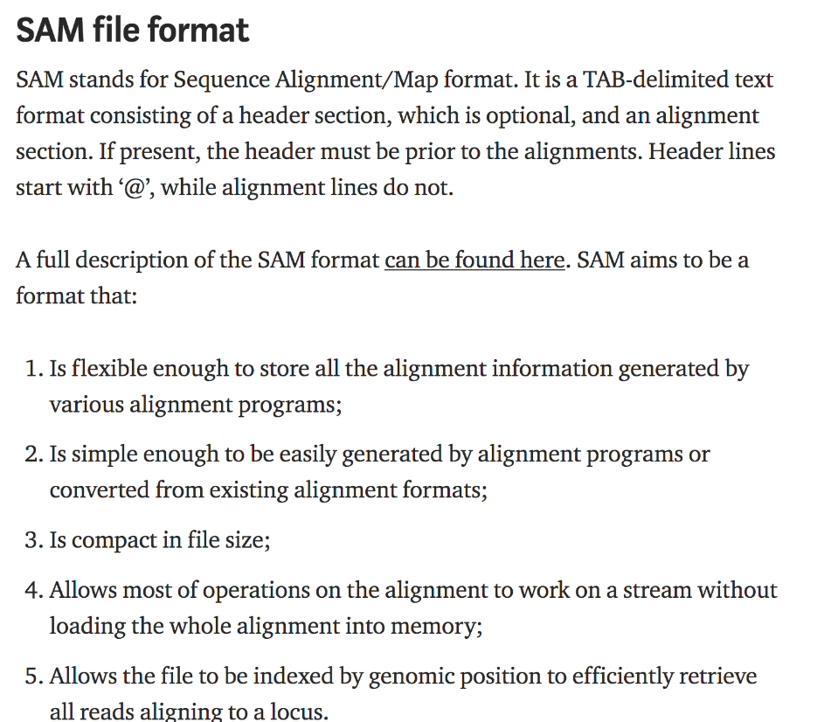
https://medium.com/@shilparaopradeep/samtools-guide-learning-how-to-filter-and-manipulate-with-sam-bam-files-2c28b25d29e8
#Picard
sam --> sorted bam
module load picard/2.17.8
#example
bsub -o log -n 1 -q short -R rusage[mem=20000] -W240 "java –jar /share/pkg/picard/2.17.8/picard.jar SortSam I=/nl/umw_anthony_imbalzano/Sabriya/TereChIP/ProlnoCu_IN_rep1.sam O=ProlnoCu_IN_rep1.sorted.bam SO=coordinate"
The BAM file must be sorted by the reference ID and then the leftmost coordinate before indexing.

Slide 20
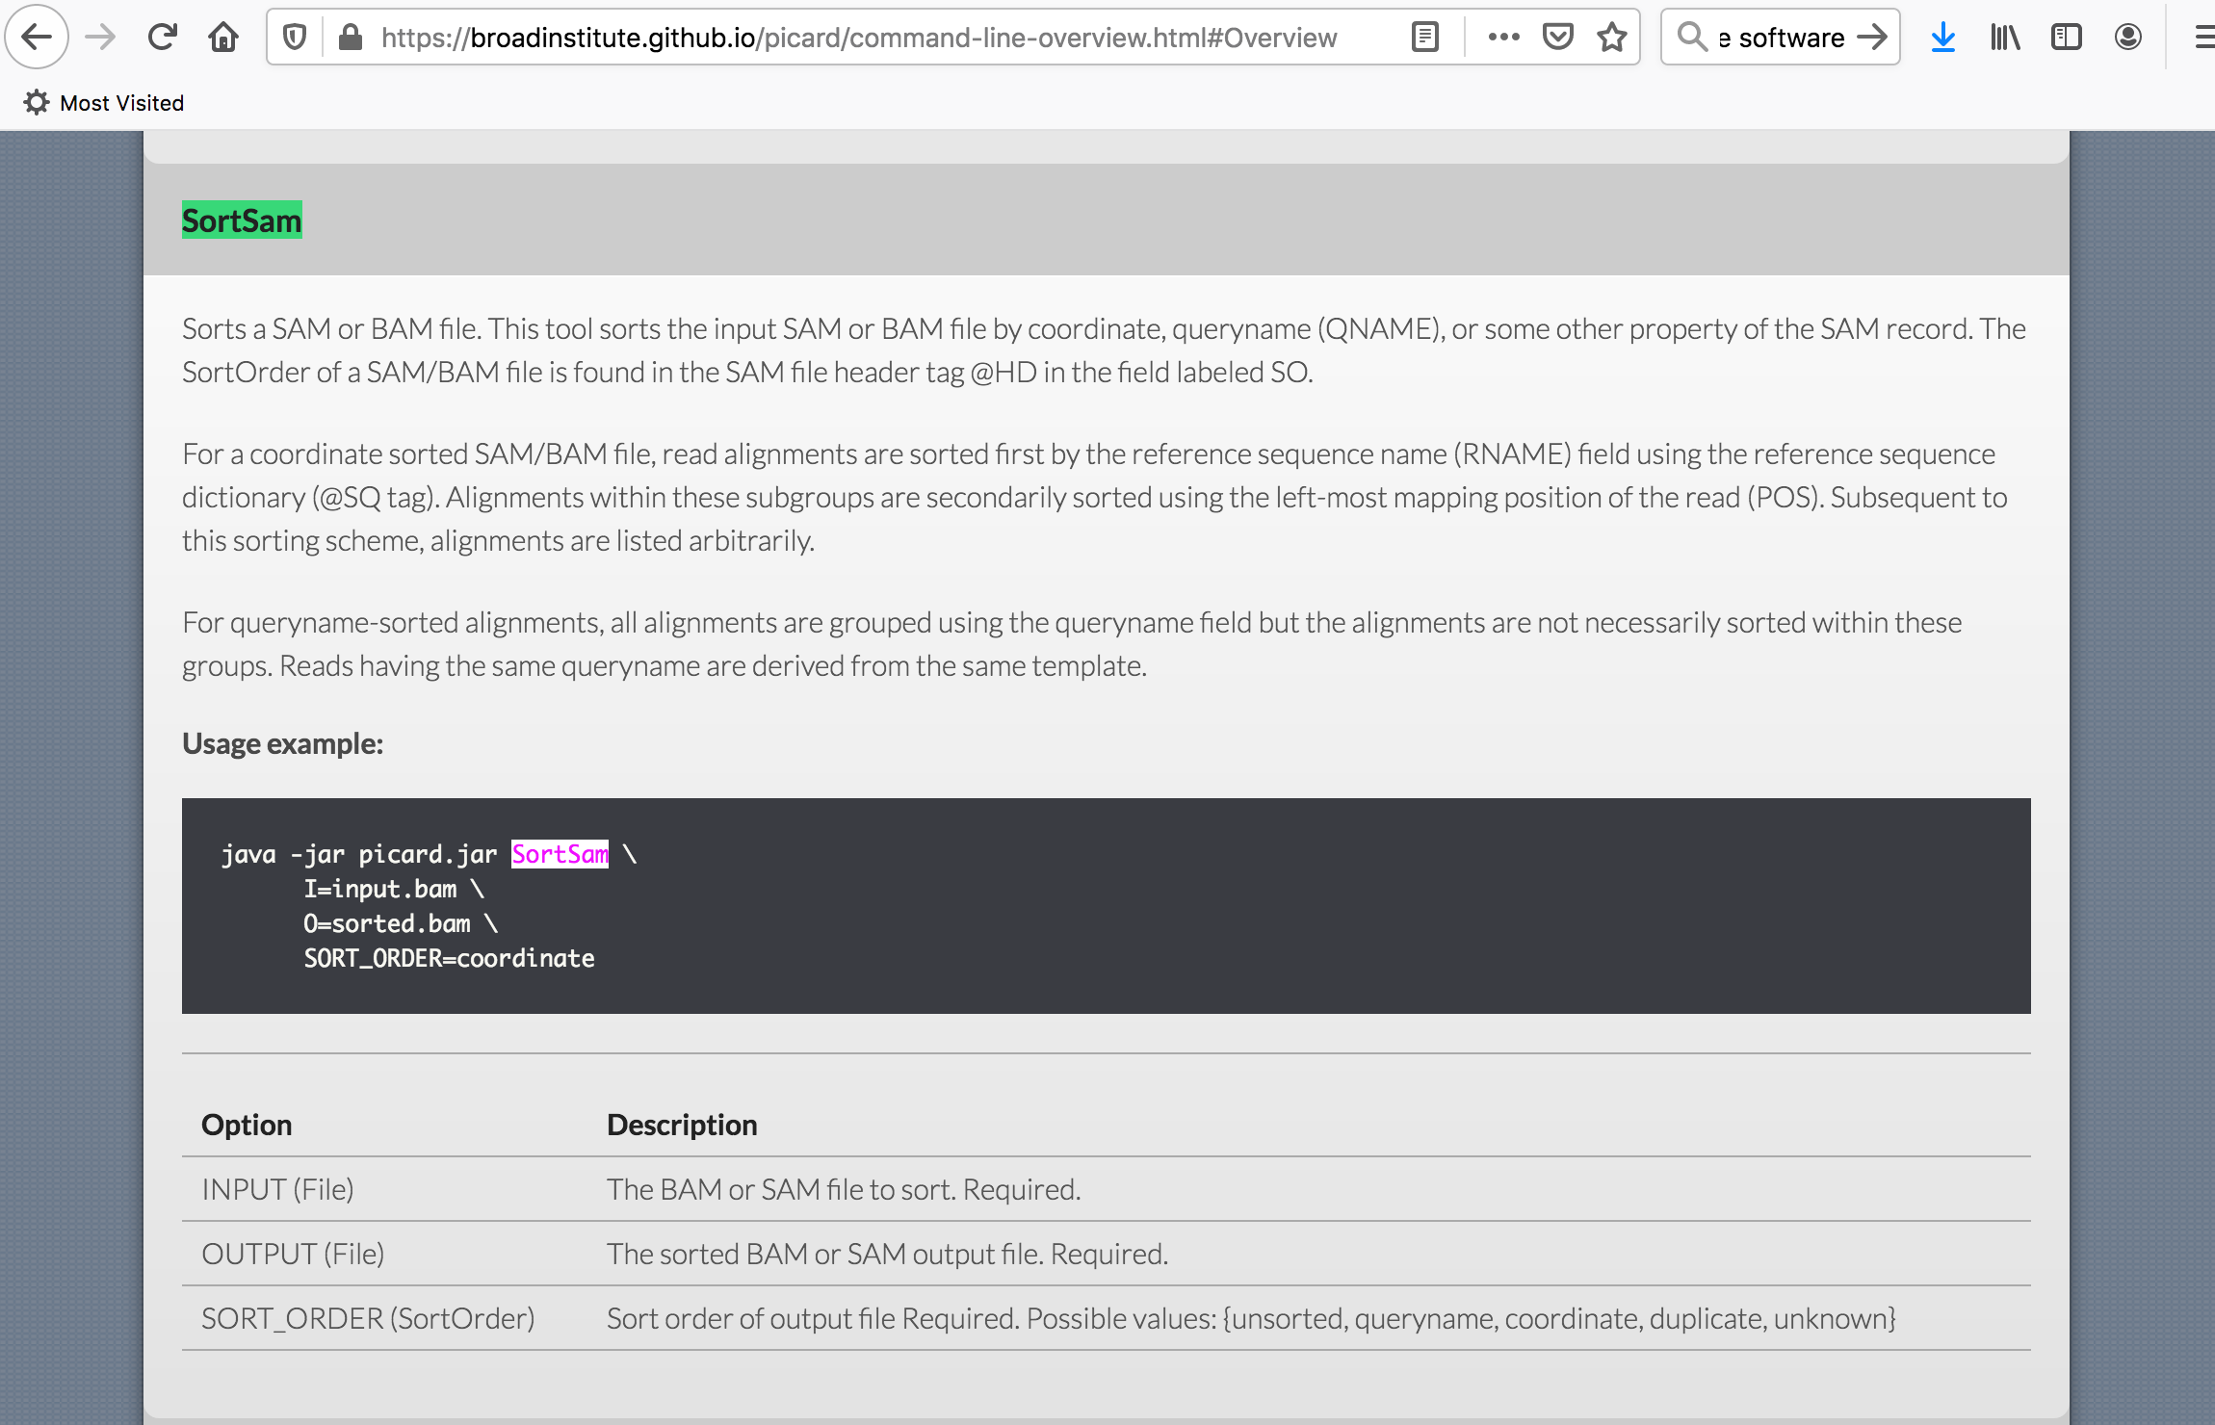

Slide 21
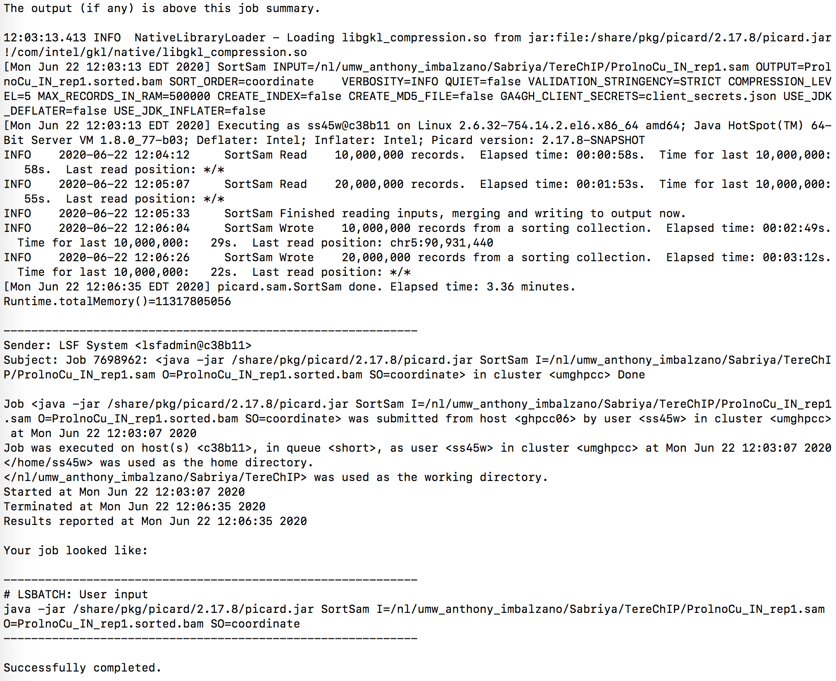
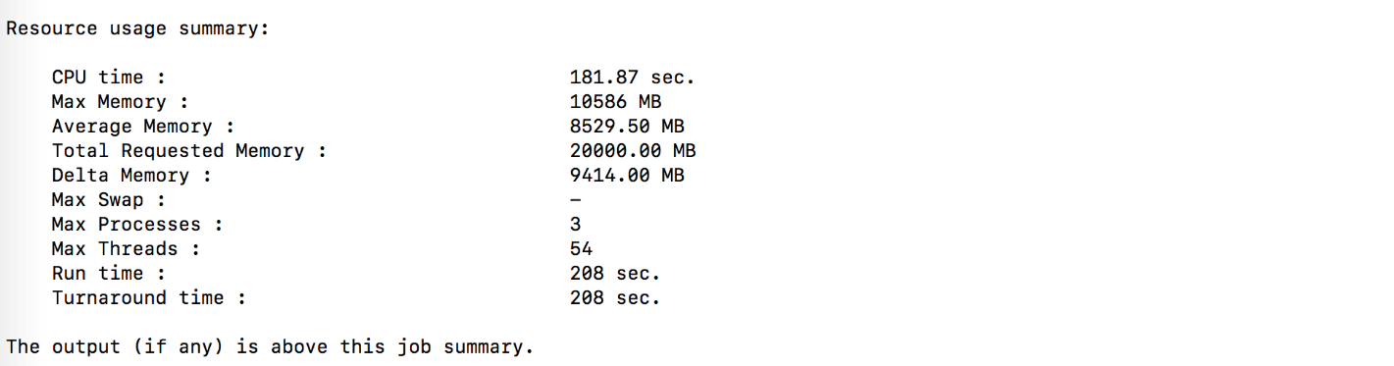

Slide 22
My ChIP-Sequencing Workflow
Raw Reads
fastq
.tdf to visualize
(IGV tools)
Map to genome (Bowtie2)
Bam Index (picard)
Sort Sam
(picard)
MAPQ filter (samtools)
Peak Analysis
(macs2)
Mark duplicates
(picard)
Merge runs
(picard)

Slide 23
#Picard
MARK DUPLICATES
module load picard/2.17.8
#example
bsub -o logX -n 1 -q short -R rusage[mem=20000] -W240 "java -jar /share/pkg/picard/2.17.8/picard.jar MarkDuplicates I=/nl/umw_anthony_imbalzano/Sabriya/TereChIP/ProlnoCu_IN_rep1.sorted.bam O=ProlnoCu_IN_rep1_sorted.dedup.bam M=markdup_metrics.txt REMOVE_DUPLICATES=true"

Slide 24
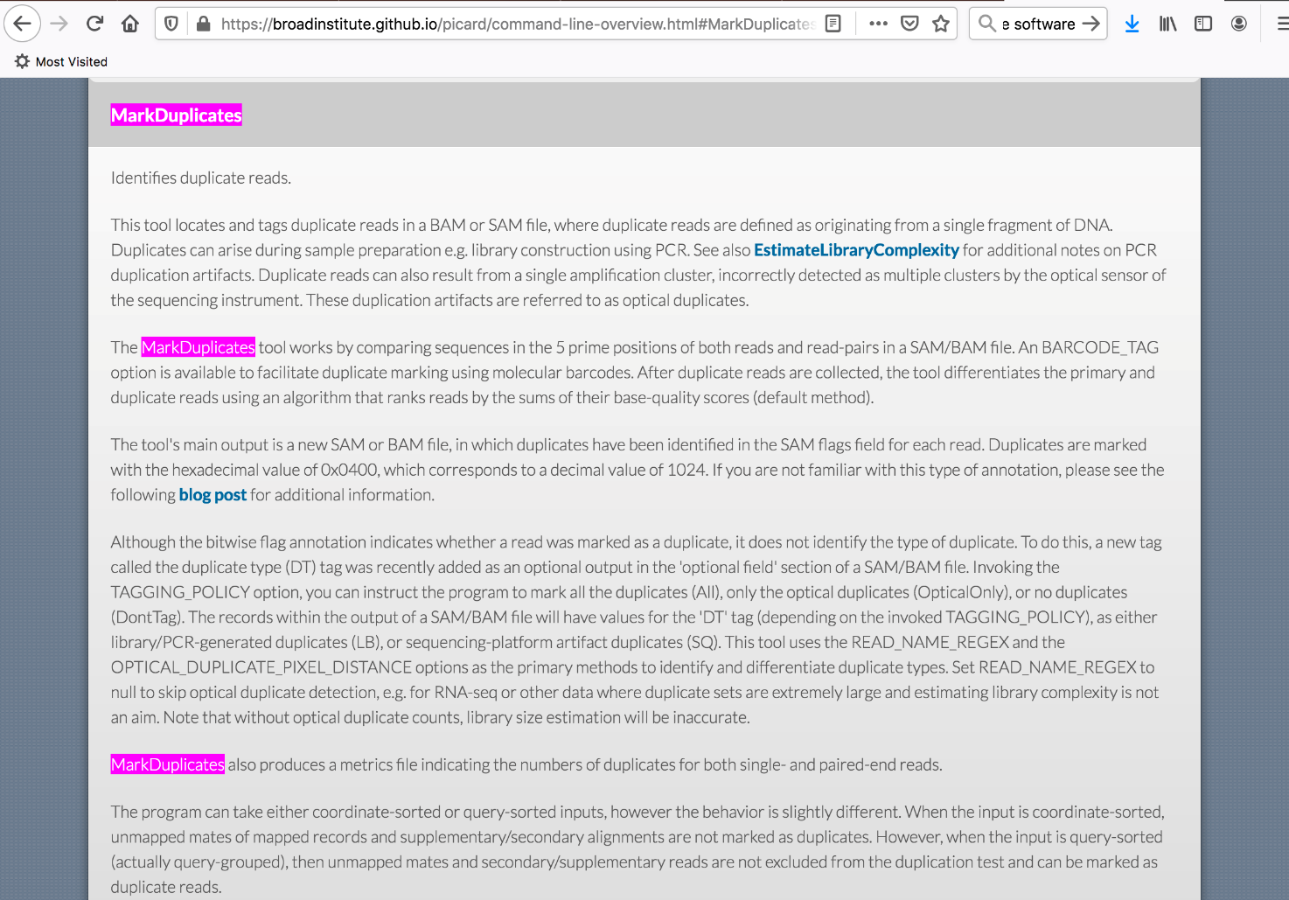
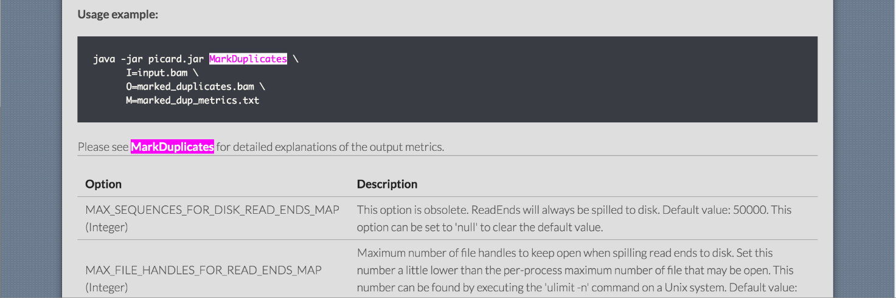

Slide 25
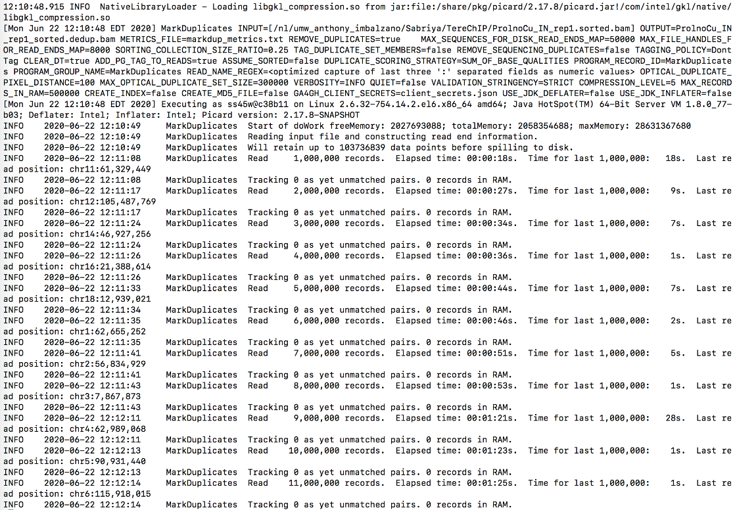
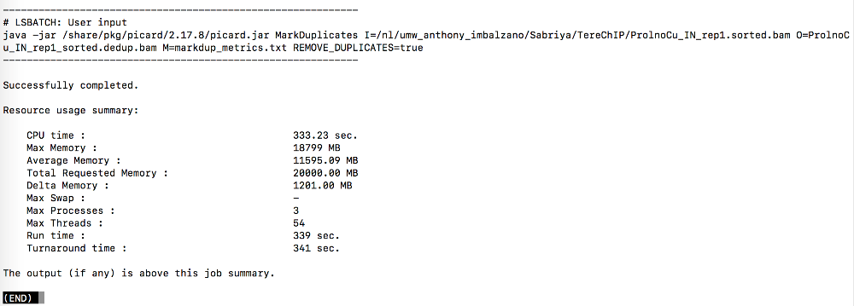
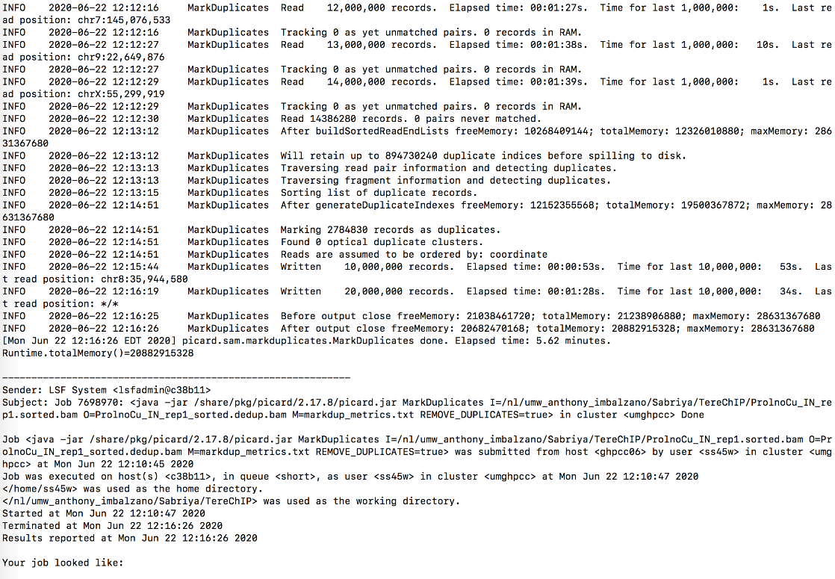

Slide 26
My ChIP-Sequencing Workflow
Raw Reads
fastq
.tdf to visualize
(IGV tools)
Map to genome (Bowtie2)
Bam Index (picard)
Sort Sam
(picard)
MAPQ filter (samtools)
Peak Analysis
(macs2)
Mark duplicates
(picard)
Merge runs
(picard)

Slide 27
#Samtools
MAPQ
MAPQ (mapping quality — describes the uniqueness of the alignment, 0=non-unique, >10 probably unique)
module load samtools/1.9
#example
bsub -n 1 -o log -q short -R rusage[mem=20000] -W240 "samtools view -q 20 -b WCE_3T3L1_all.sorted.dedup.bam > WCE_3T3L1_all.sorted.dedup.q20.bam"

Slide 28
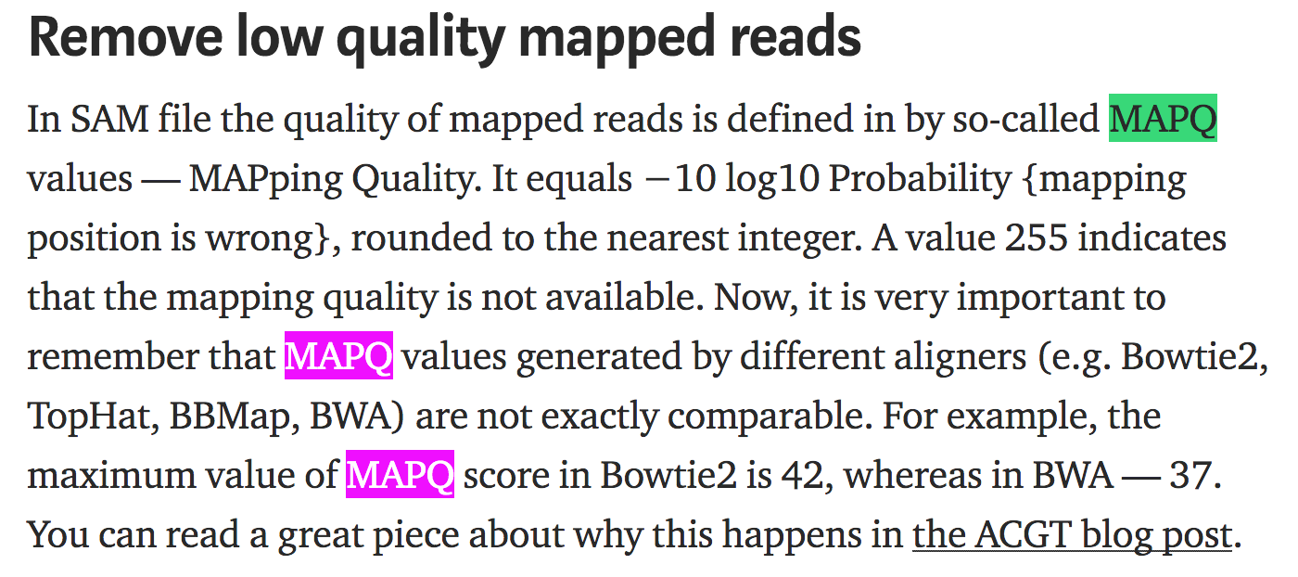
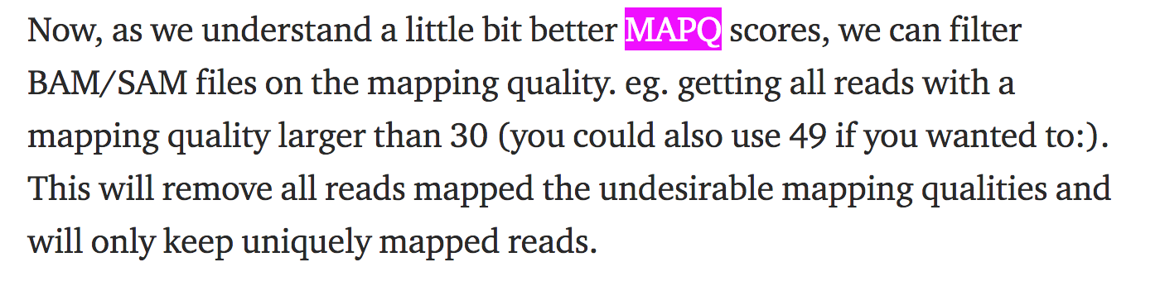
https://medium.com/@shilparaopradeep/samtools-guide-learning-how-to-filter-and-manipulate-with-sam-bam-files-2c28b25d29e8

Slide 29
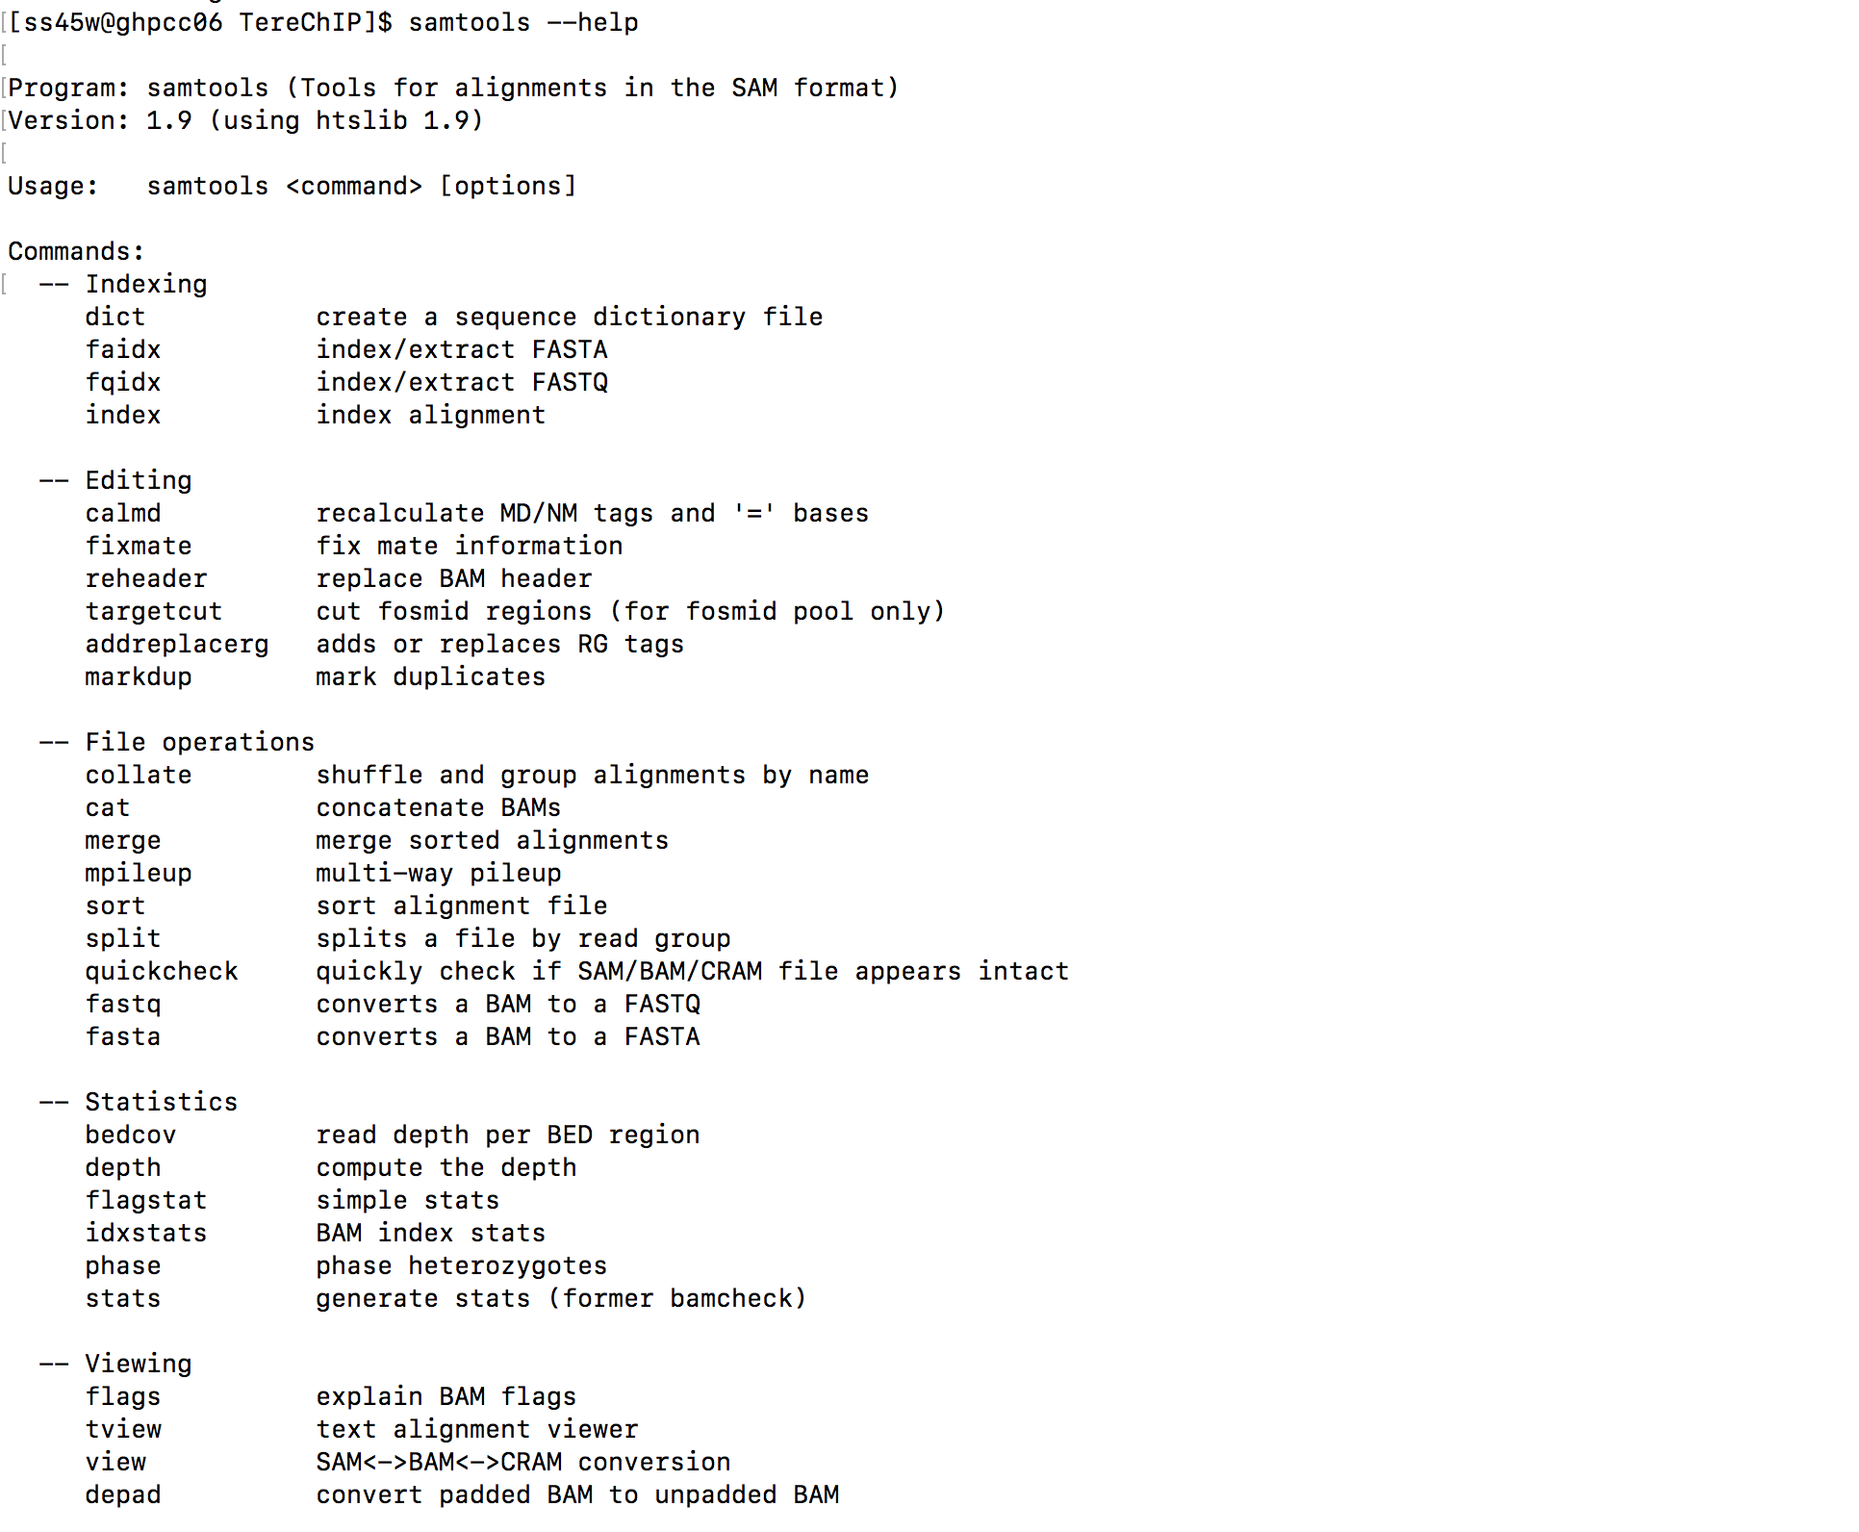

Slide 30
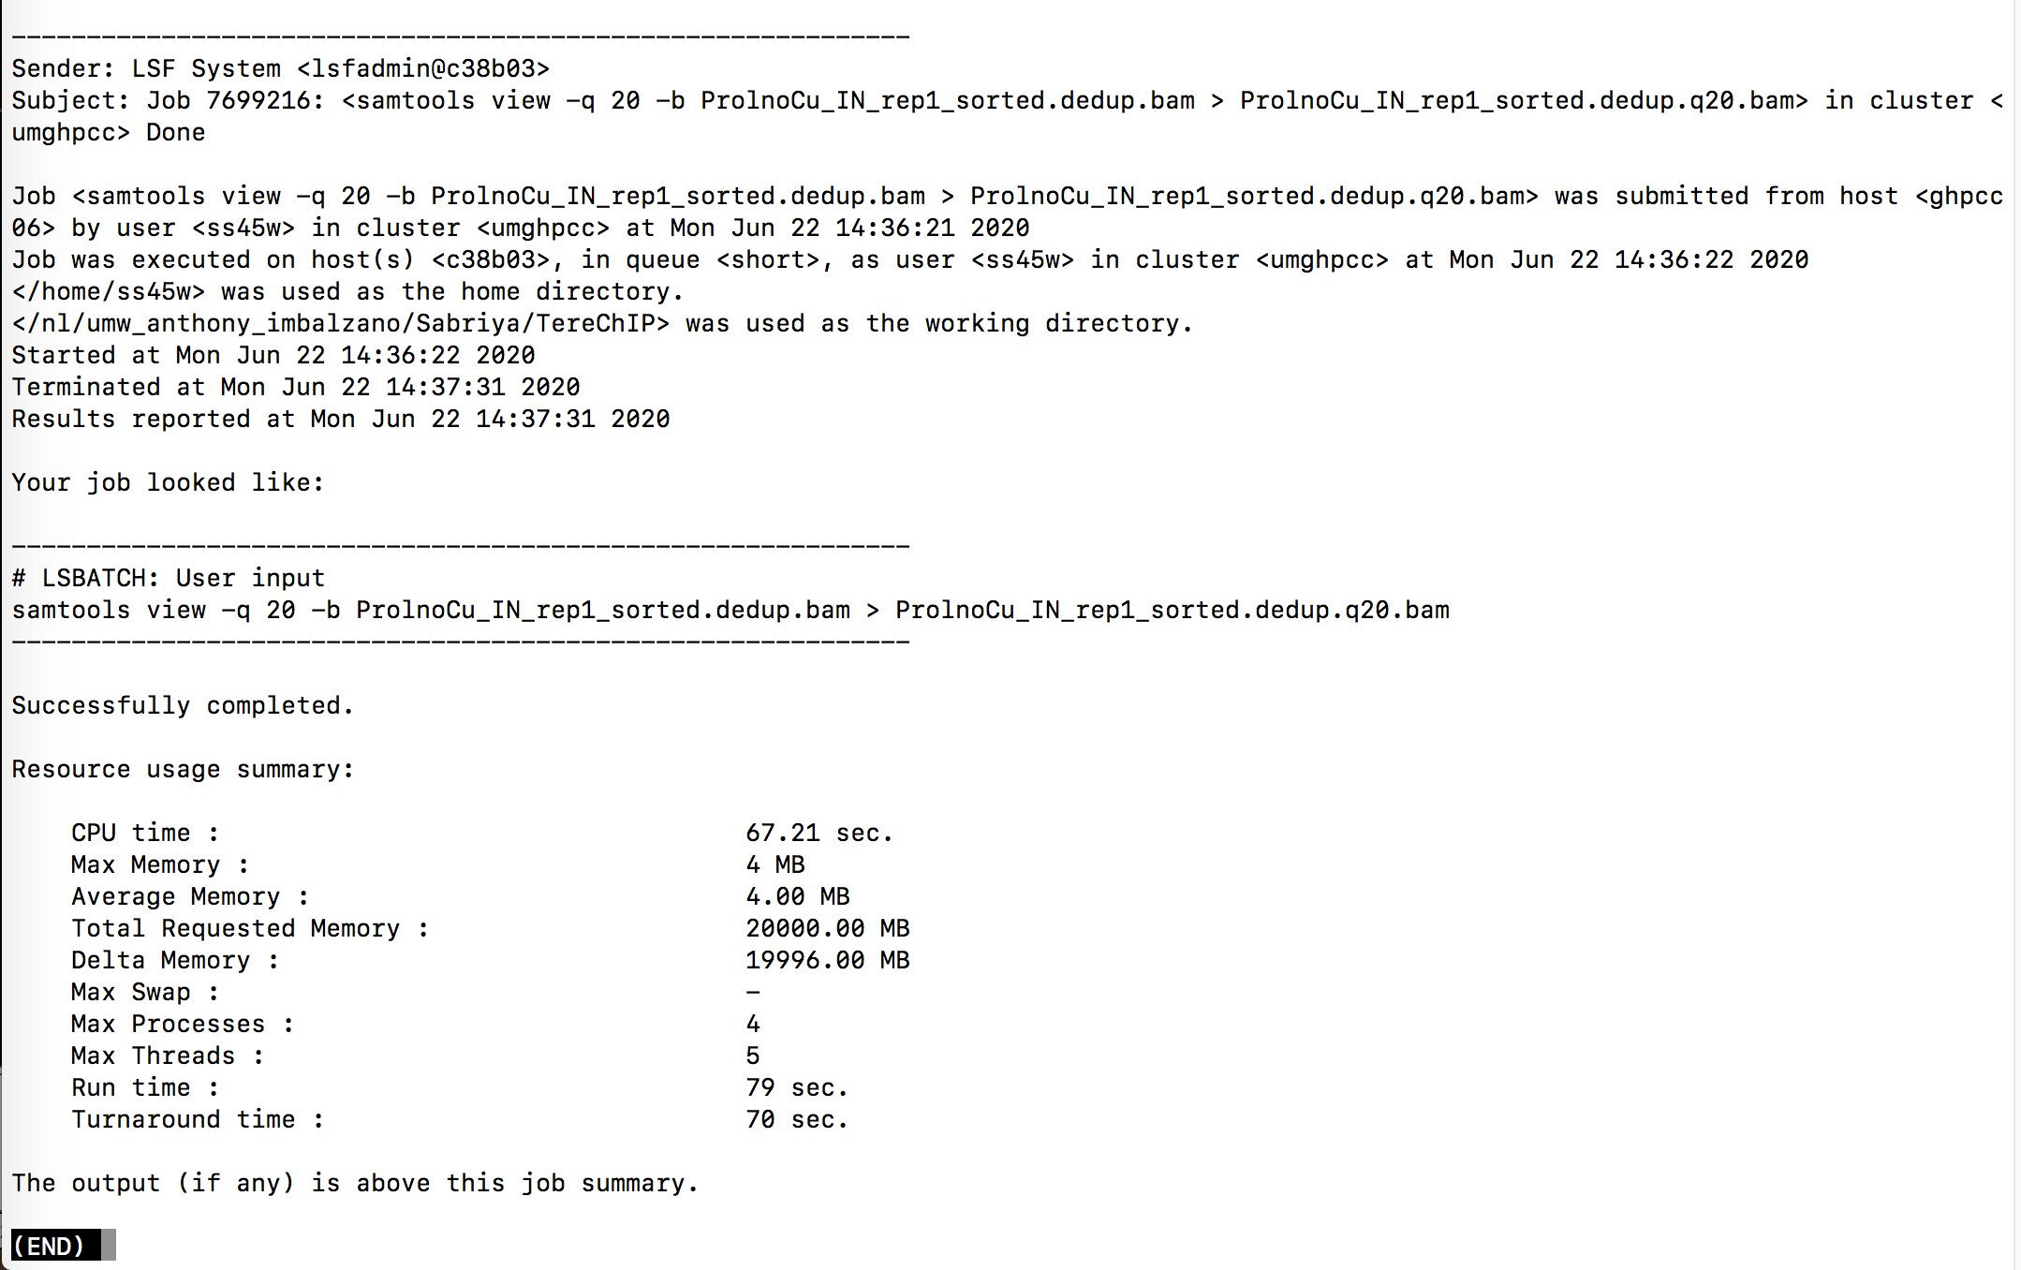

Slide 31
My ChIP-Sequencing Workflow
Raw Reads
fastq
.tdf to visualize
(IGV tools)
Map to genome (Bowtie2)
Bam Index (picard)
Sort Sam
(picard)
MAPQ filter (samtools)
Peak Analysis
(macs2)
Mark duplicates
(picard)
Merge runs
(picard)

Slide 32
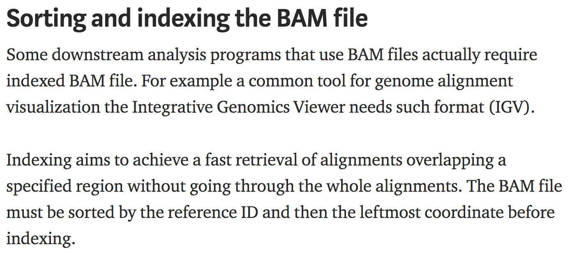
https://medium.com/@shilparaopradeep/samtools-guide-learning-how-to-filter-and-manipulate-with-sam-bam-files-2c28b25d29e8
#Picard
Build merged Bam Index
module load picard/2.17.8
#example
bsub -o log3 -n 1 -q short -R rusage[mem=20000] -W240 "java -jar /share/pkg/picard/2.17.8/picard.jar BuildBamIndex I=ProlnoCu_IN_rep1_sorted.dedup.q20.bam"

Slide 33
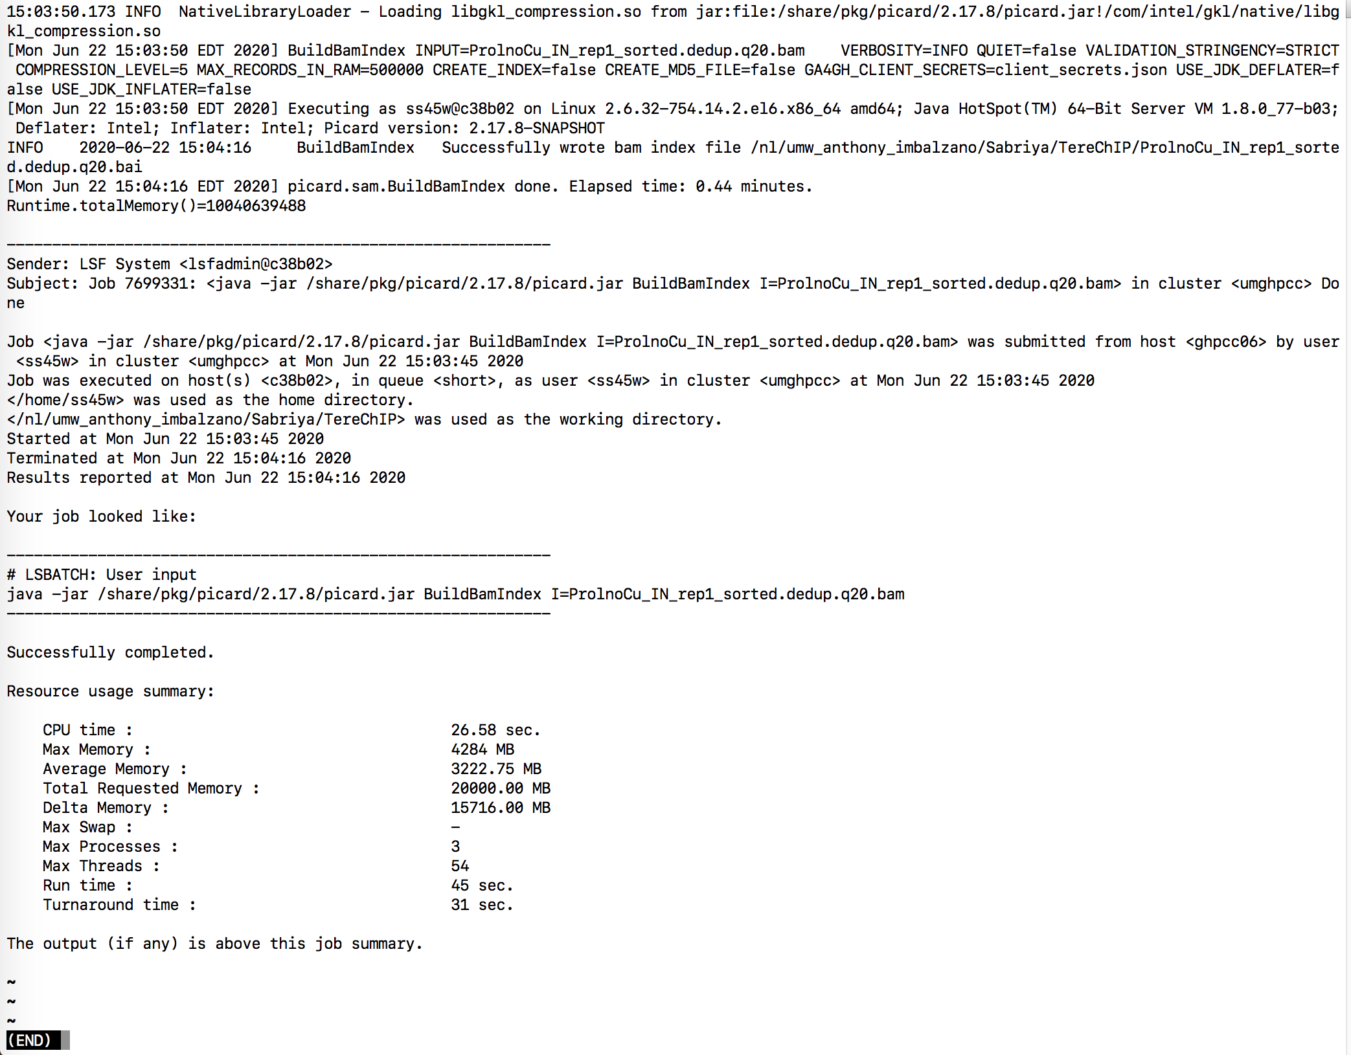

Slide 34
My ChIP-Sequencing Workflow
Raw Reads
fastq
.tdf to visualize
(IGV tools)
Map to genome (Bowtie2)
Bam Index (picard)
Sort Sam
(picard)
MAPQ filter (samtools)
Peak Analysis
(macs2)
Mark duplicates
(picard)
Merge runs
(picard)

Slide 35
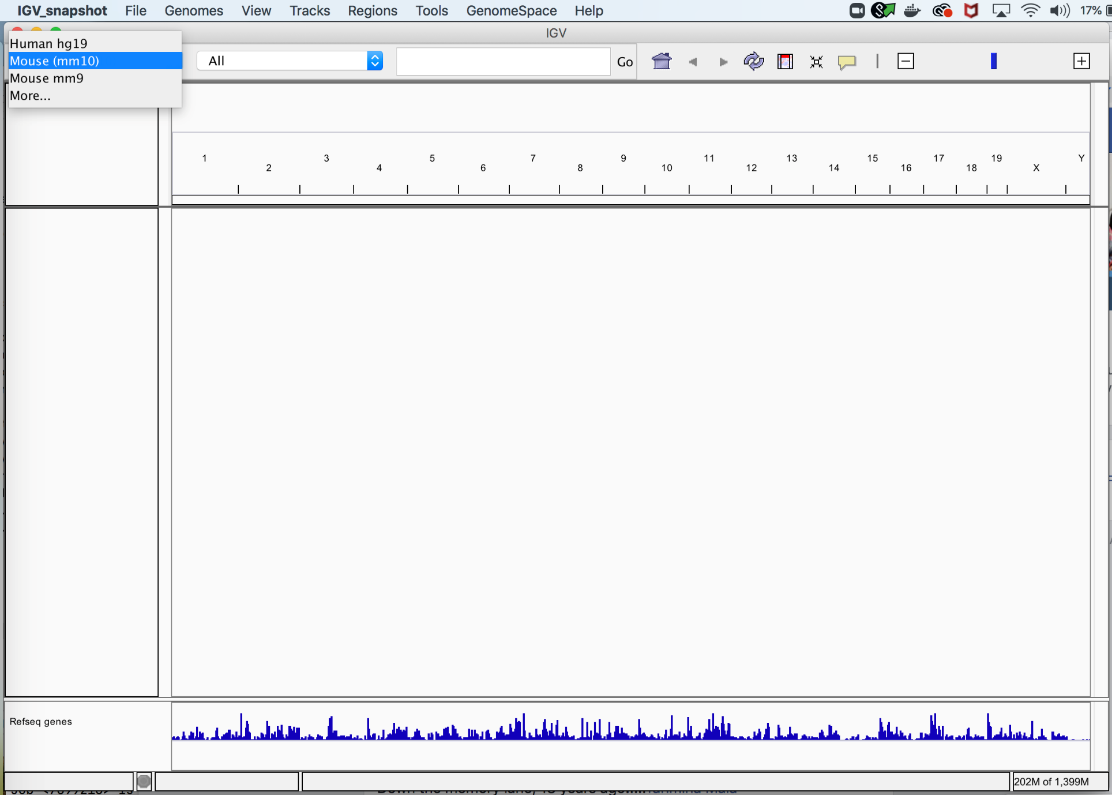
Select mm10 genome

Slide 36
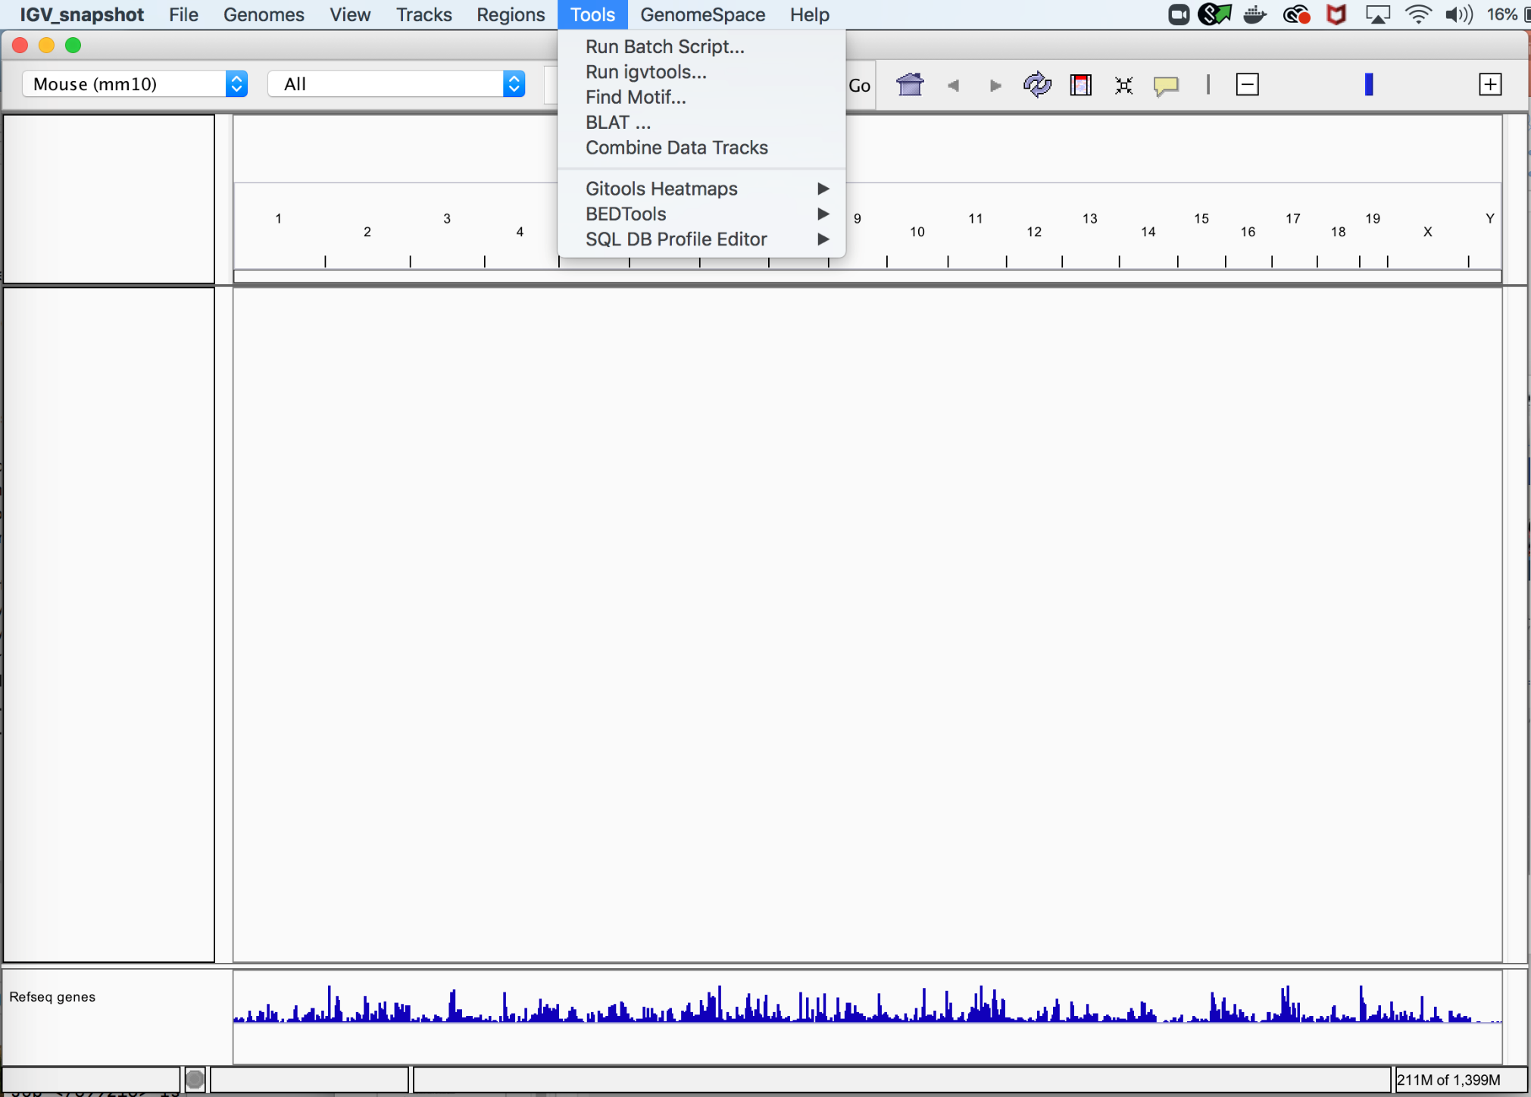
Select Tools → Run Igvtools

Slide 37
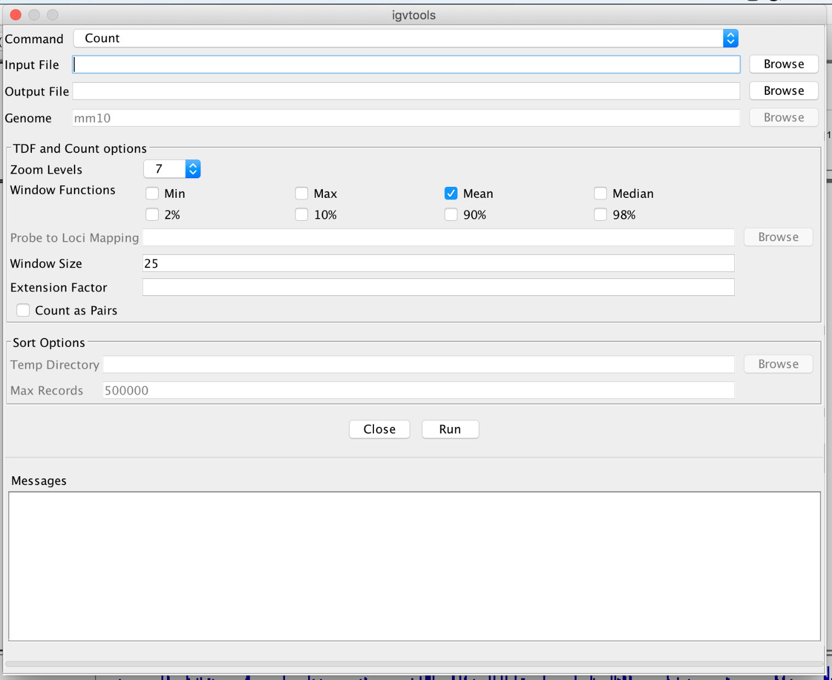
Input file: your bam
Output file: will keep same naming but append a .tdf
Then select Run. It will take 5-10 minutes to generate the .tdf file

Slide 38
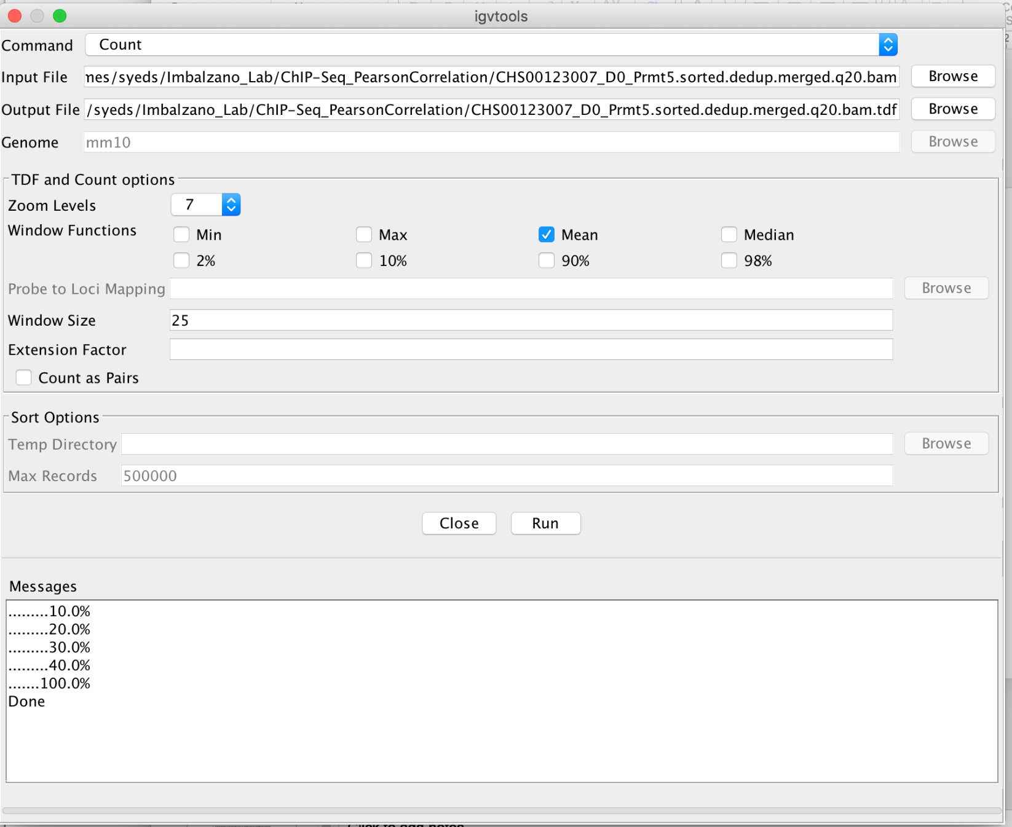
.tdf file can be loaded into IGV easily for viewing
Several .tdf files can be loaded together and saved as a session as well.

